Slide 1

Linked List - Theory
BCSC 0015 Applied Data Structures and Algorithms

Slide 2
Linked List
Linked List provides an alternative to an array based structure.
Array has size limitation, but Linked list didn’t have that limitation
Linked List in its simplest form, is a collection of nodes that collectively form a linear sequence.

Slide 3
Linked List
Each node is connected to the next node in sequence.

Slide 4
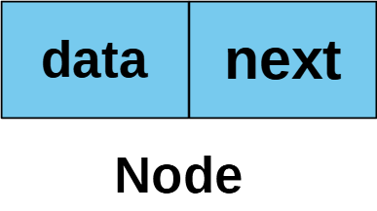
Node in Linked List
In linked list, each node stores a reference to an object (data/information) that is an element of sequence, as well as a reference to the next node of the list.

Slide 5
Linked List
Consider the following sequence 12, 8, 6 20, 2.
A linked list to represent it will look like :

Slide 6
Linked List - head/start
Each linked list instance contains a head or start reference.
Head refers to the first node of the linked list.
Head is an external reference, that is, head is not part of linked list sequence.

Slide 7
Linked List – tail / end
The last node of the linked list is also known as tail.
The last node of linked list is the node whose next reference refer to null

Slide 8
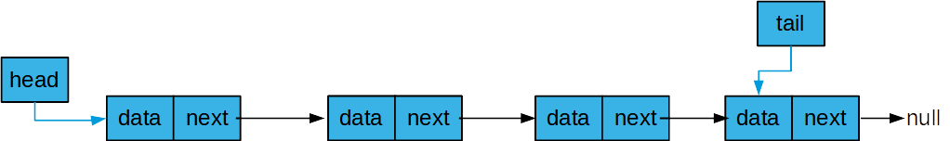
Linked List – tail / end
The last node of linked list can be found by traversing the linked list –
starting from head and moving from one node to another by following the each node’s next reference.
This process is known as link hopping or pointer hopping.

Slide 9
Linked List – tail / end
Like head, a linked list can also contain a tail reference, but its not compulsory for linked list to keep tail reference.
Tail helps in operational efficiency.

Slide 10
Linked List – size
It is common for a linked list instance to keep count of the total number of node that are in linked list, also know as size of list.
If linked list instance don’t keep size, then we have to count nodes each time by traversing the linked list for getting number of nodes in list.
This process will cost O(n) each time. Its better to keep size.

Slide 11
Types of linked list
There are three types of linked list
Singly linked list
Doubly linked list
Circular linked list
Circular list can be
Singly circular linked list
Doubly circular linked list

Slide 12

Singly Linked list
In singly linked list each node refers to the next node in the linked list.
You can only traverse in forward direction, one way only.
A singly linked list node contains a data field and reference to next node of the linked list.
The next reference of last node of singly linked list refer to null

Slide 13
Singly Linked List

Slide 14
Doubly linked list
In Doubly linked list each node can refers to next node in the linked list as well as refers to the previous node in the linked list.
You can traverse in both direction, forward and backwards

Slide 15


Doubly linked list
A Doubly linked node contains a data field, next reference and previous reference.
The next reference of last node refers to null and previous reference of first node will also refers to null.

Slide 16
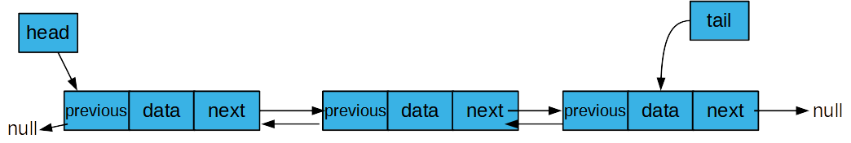
Doubly Linked List
The next reference of last node refers to null and previous reference of first node will also refers to null.

Slide 17
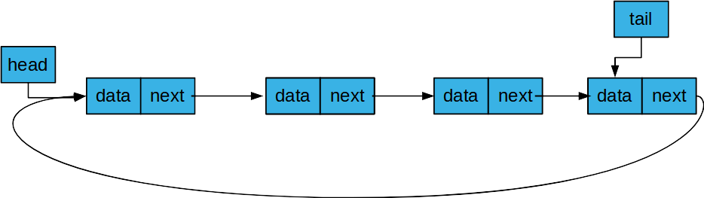
Circular Linked list
In circular linked list, last node next reference refers to the first node of the linked list. This gives it circular behavior.
Singly circular linked list will look like:

Slide 18
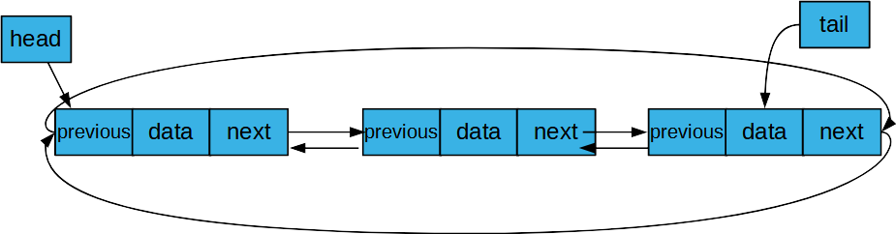
Doubly Circular Linked list
In Doubly circular linked list, last node next reference refers to the first node of the linked list. And first node previous reference refer to last node. This gives it circular behavior.
Doubly circular linked list will look like:

Slide 19
Operations on Linked List
All the data structure operations can be performed on linked list.
Like,
Insert
Delete
Traverse
Search
Sort
Merge

Slide 20
Insert Operation
In linked list, a new node can be inserted or added.
In the beginning of linked list
In the end of linked list
Between two nodes,
After a given node (containing given element)
Before the given node (containing given element)
At particular position k (positional insert)

Slide 21
Insert operation
To insert a newNode in linked list, you have to change the next reference newNode to refer to the next reference of existing node, the existing node to refer to newNode.
In case of addFirst:
head will refer to newNode and newNode next reference will refer to existing linked list, if linked list is empty head and tail both refer to newNode.
In case of addLast:
Tail node (last node) next reference will refer to newNode and tail will also refer as newNode will be the tail now. If linked list is empty then tail and head both refer to newNode.

Slide 22
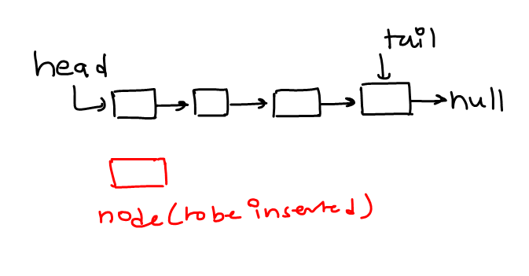
Insert In the beginning of linked list
InsertAtHead or addFirst
node next reference will refer to existing list referred by head.
Then head will refer to node, node will be new head

Slide 23
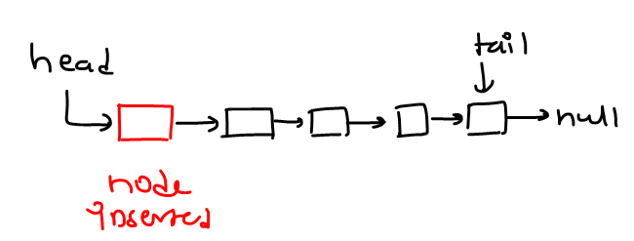
Insert In the beginning of linked list
InsertAtHead or addFirst

Slide 24
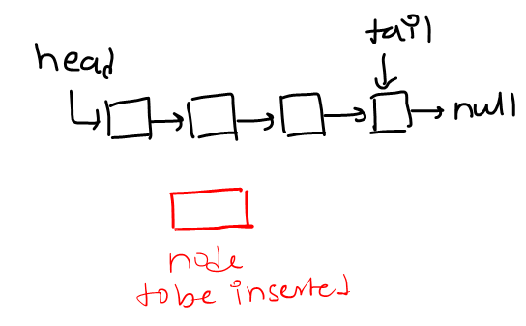
Insert In the end of linked list
InsertAtLast or addLast
node next will refer to null.
tail (last node) next reference will refer to node.
tail will refer to node, as node will be new tail

Slide 25
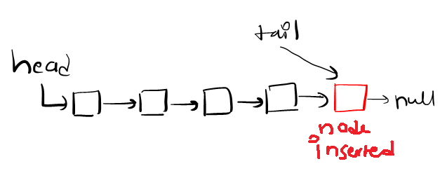
Insert In the end of linked list
InsertAtLast or addLast

Slide 26
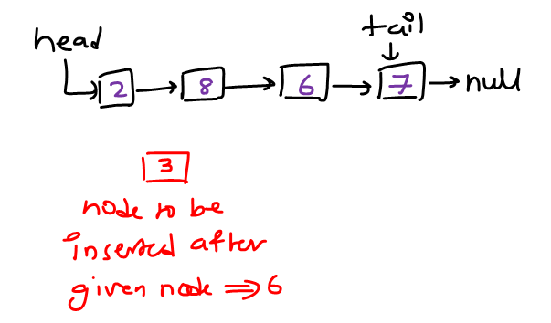
Insert Between two nodes
After a given node (containing given element)
For this we will traverse from head, and find the node containing given element. If not present node will not be inserted
node next will refer to the next reference of node containing element.
node (containing element) next reference will refer to node.

Slide 27
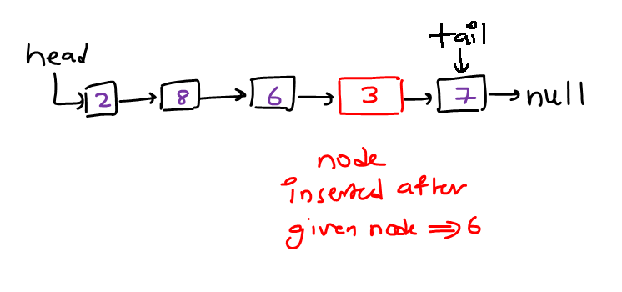
Insert Between two nodes
After a given node (containing given element)

Slide 28
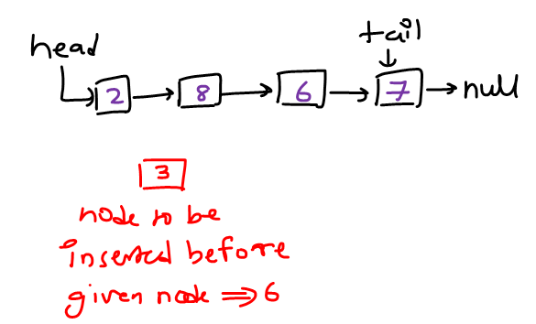
Insert Between two nodes
Before the given node (containing given element)
For this we will traverse from head, and find the node containing given element. If not present node will not be inserted.
For inserting we need reference of the previous node.
node next will refer to the next reference of previous node.
previous node next reference will refer to node.

Slide 29
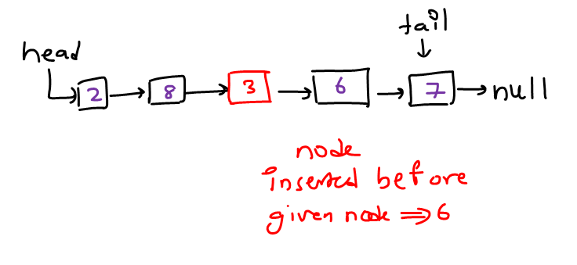
Insert Between two nodes
Before the given node (containing given element)

Slide 30
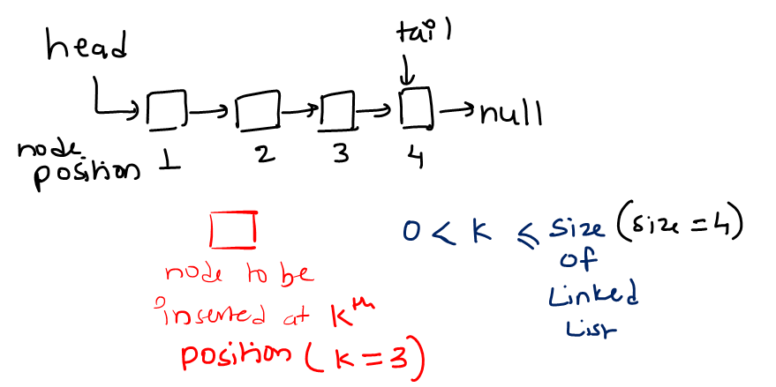
Insert Between two nodes
At particular position k (positional insert)
If k is valid position, i.e. 0 < k <= size, we will identify k – 1 node.
If k is invalid will not insert.
Node next reference will refer to k – 1 node next reference.
K – 1 node next will refer to node.

Slide 31
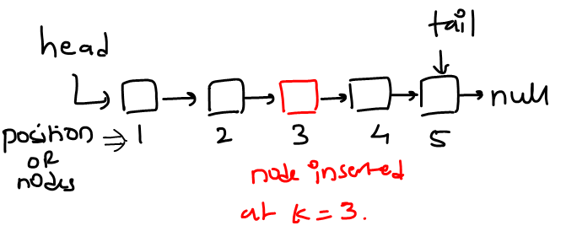
Insert Between two nodes
At particular position k (positional insert)

Slide 32
Delete Operation
In linked list, a node can be deleted or removed.
From the beginning of linked list
From the end of linked list
In-between two nodes,
Delete a given node (containing the given element)
From particular position k (positional insert)

Slide 33
Delete Operation
To delete a node from linked list, we have to change the next reference of the node which is just before the deleting node, we will call it previous node.
We will change the previous node next reference to deleting node next reference.

Slide 34
Delete Operation
If the deleting node is first node, then head will refer to deleting node next reference.
If the deleting node is last node, then tail will refer to previous node, which is the new tail(last node).

Slide 35
Delete From the beginning of linked list
DeleteFromHead or removeFirst
head will refer to next reference of the first node (head next).
If there is one node, then head and tail both refer to null.

Slide 36
Delete From the beginning of linked list
DeleteFromHead or removeFirst

Slide 37
Delete From the end of linked list
DeleteFromTail or removeLast
To delete from last, we have to traverse from head and reach the node before the last node, we call it previous node.
previous node next reference will refer to null.
tail will now refer to previous node

Slide 38
Delete From the end of linked list
DeleteFromTail or removeLast

Slide 39
Delete from In-between two nodes
Delete a given node (containing given element)
To delete a given element, we have to traverse from head to given element node and also save a reference to node before it, we call it previous. If not present in linked list, deletion will not performed.
Previous node next reference will refer to deleting node next reference.

Slide 40
Delete from In-between two nodes
Delete a given node (containing given element)

Slide 41
From particular position k (positional delete)
If k is valid position, 0 < k <= size then delete is performed otherwise delete operation will not performed.
We will start from head and find the k – 1 node.
Then k – 1 node next reference will refer to kth node next reference

Slide 42
Delete from In-between two nodes
From particular position k (positional insert)

Slide 43
Traversing Linked List
Traversing means visiting each node of linked list, starting from head to last node.
Traverse operation is need for processing each node. Like:
Print node’s value(data field)
Searching an element in linked list
Sum of all element of sequence.

Slide 44
Traversing Linked List
As we all know linked list known by its head reference, so we assign head reference to a temp reference for traversing.
Starting from head node, we will visit each node by getting the reference of next node in sequence, until we reach end of linked list

Slide 45
Traversing Linked List
Assign head reference to temp.
On each iteration updating the temp, by temp node next reference
Repeat until temp is null, temp refer to null when no more elements of left to be traversed

Slide 46
Search Operation
Searching a given value (searchKey) in linked list.
To search, you have to traverse from head, by using a temp reference and comparing serachKey in each node data. If searchKey is present you will find in node containing searchKey otherwise temp will reach end of linked list.
Until temp not reach end of list, compare temp data with search key, if matched stop otherwise update temp by temp node next reference

Slide 47
Sort operation
Sorting means arranging the element of linked list in some order (ascending / descending).
You can sort by re-arranging nodes by changing there next reference or by switching the data value of the nodes.

Slide 48
Sort operation
Repeat the process till all nodes reach there ordered position.
There are many sorting algorithms, some take less time then other.

Slide 49
Sort Operation

Slide 50
Merge Operation
Merging to linked list (sorted linked list).
Merging two un-sorted list is easy, you can add the second list at the end of first list or vice-versa.
But merging to sorted list and getting a new sorted list containing both element require comparison of each node first list to another node of second list and then adding the smaller node in new list

Slide 51
Merge Operation
If Both lists are un-sorted, you can merge list 2 at the end of list 1. And update the tail

Slide 52
Merge Operation
For sorted list, you have to arrange nodes in their proper position.
Compare , list1 first node with first node of list 2, add smaller node in new linked list, repeate the process, until list is arraganed.

Slide 53
THANK YOU

